Slide 1
Team Amazon
Introduction & Aim
Amazon Family of Products
Data Analysis:
Amazon Ratings
Amazon Reviews
EBay
Conclusions
Team: Steve, Nengjun, John, Bolun & Jennifer
BIA660-Web Analytics

Slide 2




Introduction & Aim
Aim: To evaluate consumer perception of Amazon Kindle products.
Project Scope: E-readers, NOT Tablet Devices.
Primary Function: Reading Books.
Attributes: Long Battery Life, Large Screen & Wi-Fi Connectivity.
Data Sources:

Slide 3

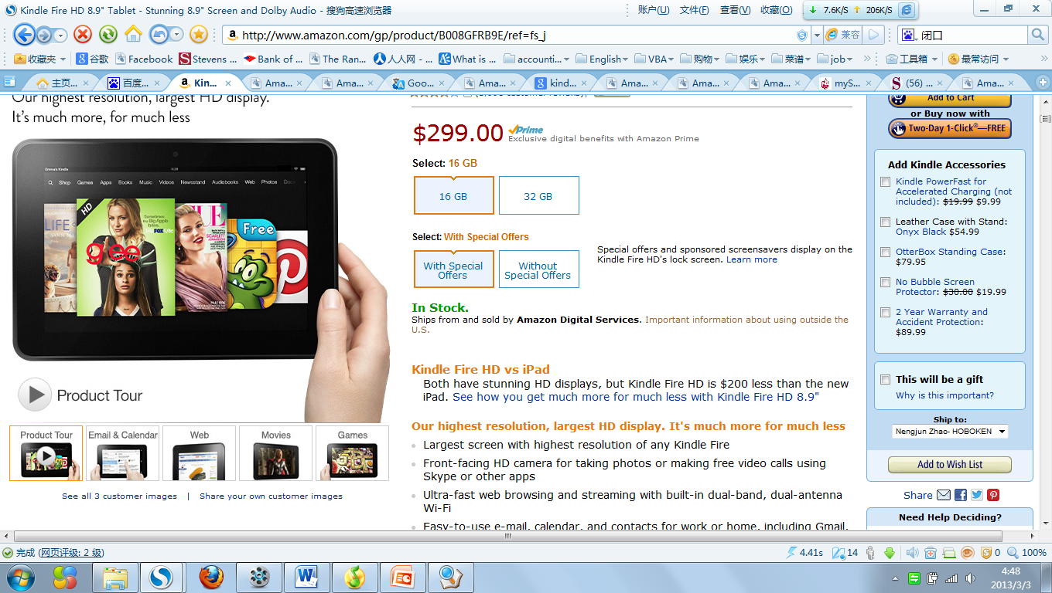






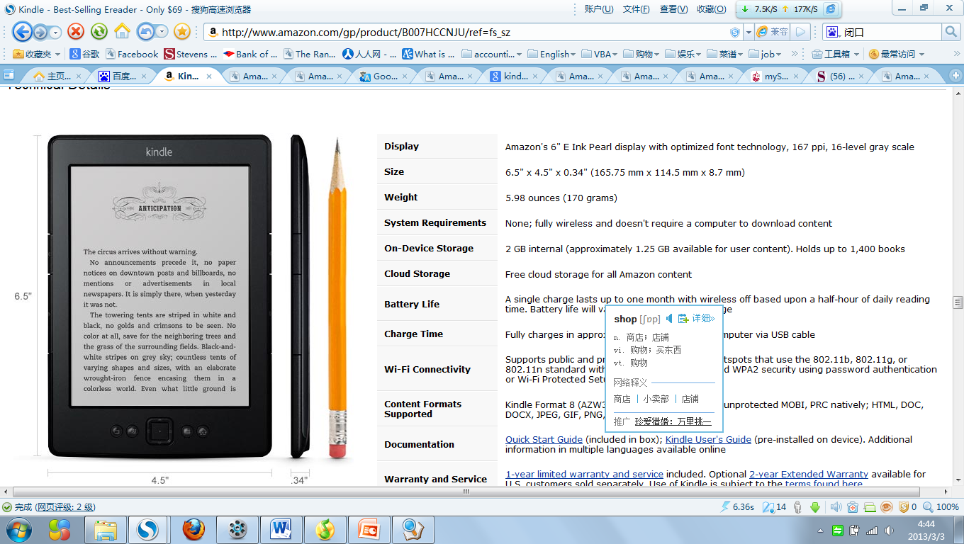
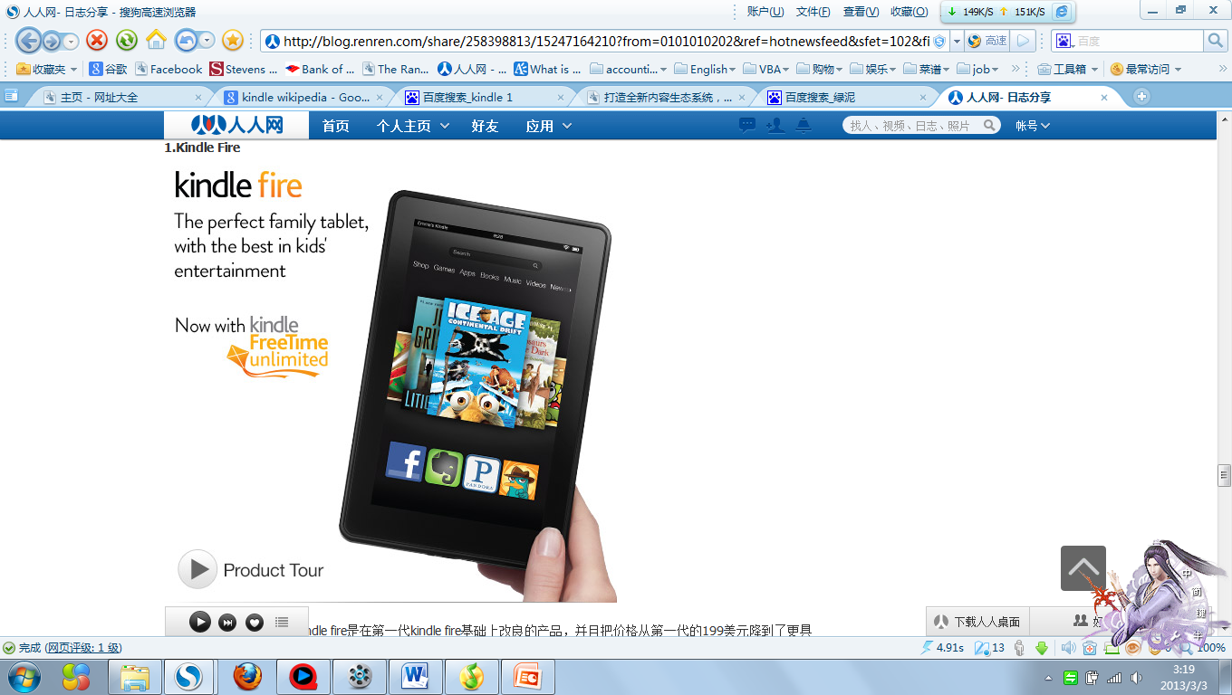
Amazon Introduced a large 9.7-inch kindle DX. It shipped by June. 10, 2009
Introducing the All-New Kindle Family include fourth generation Kindle, Kindle Touch, Kindle Touch 3G, and Kindle fire.
First kindle came and sold out in 5.5 hours.
Kindle Family：fourth generation Kindle, Kindle Touch, Kindle fire.
First kindle
Kindle DX
Nov. 19 2007
Feb. 9, 2009
May. 6, 2009
Jul 28, 2010.
Sep 28, 2011.
Sep 6, 2012.
Amazon announced a New Generation of Kindle. A month later it become the best seller in amazon.
Introduce Kindle, Kindle Paperwhite, Kindle Fire HD
Feb. 9, 2009 amazon introduced Amazon Kindle 2. Feb. 23, 2009, kindle is shipping. And it become the No. 1 seller in Electronics on the Amazon.com Web site in just 15 days since it was introduced.
Kindle 2
Third Generation Kindle
Notes:
Kindle Family tree
First kindle came and sold out in 5.5 hours. Nov.19, 2007.
Feb. 9, 2009 amazon introduced Amazon Kindle 2. Feb. 23, 2009, kindle is shipping. And it become the No. 1 seller in Electronics on the Amazon.com Web site in just 15 days since it was introduced.
Amazon Introduced a large 9.7-inch kindle DX. It shipped by June. 10, 2009
Amazon announced a New Generation of Kindle. A month later it become the best seller in amazon. Jul 28, 2010
Introducing the All-New Kindle Family include fourth generation Kindle, Kindle Touch, Kindle Touch 3G, and Kindle fire. Sep 28,2011
Introduce Kindle, Kindle Paperwhite, Kindle Fire HD , Sep 6, 2012

Slide 4
Kindle Fire HD 7-inch begins shipping
Kindle Paperwhite Now Available to Customers in over 175 Countries
Kindle Fire is sold out,
Kindle Fire HD 8.9” begins shipping
Introduce Kindle, Kindle Paperwhite, Kindle Fire HD
Kindle Paperwhite Shipping
Cyber Monday big day for Kindle sales
Aug. 30, 2012
Sep. 6, 2012
Sep. 14, 2012
Oct,10, 2012
Nov. 15, 2012
Nov. 27, 2012
Jan, 25, 2013
Notes:
Detail of research predio
Amazon announced that Kindle Fire is sold out, and that in just nine months, Kindle Fire has captured 22% of tablet sales in the U.S.
Introducing the New Kindle Fire HD Family, New Kindle Paperwhite and the fifth generation Kindle
7-inch Kindle Fire HD begins shipping
Kindle Paperwhite Begins Shipping
Kindle Fire HD 8.9” begins shipping
Amazon today announced that this Black Friday and Cyber Monday were the best ever for the Kindle family, and the popular new Kindle e-readers and tablets remain at the top of Amazon’s best sellers list worldwide.
Kindle is the world’s #1 best-selling e-reader for five years running, and tens of millions of readers are already reading on Kindle.

Slide 5
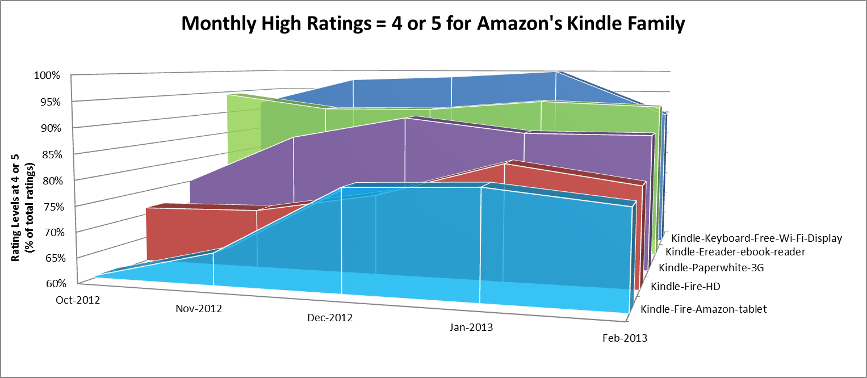
Amazon Ratings

Slide 6
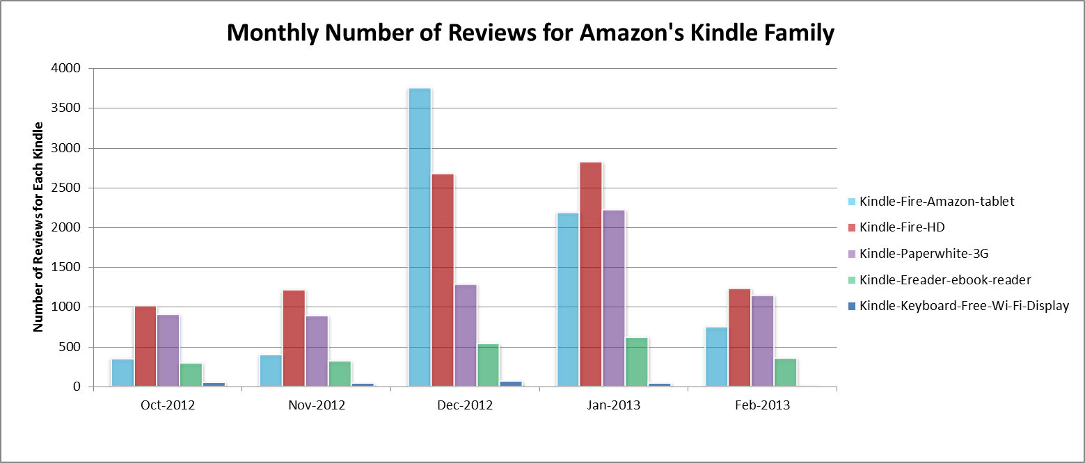
Amazon Reviews

Slide 7

eBay Recommendations 2012
Based on purchases on eBay in 2012 the most highly recommended Kindle was, the Kindle Keyboard.
Followed by Kindle Fire HD with 90% recommendation and the Kindle Fire 4GB as a close second at 89.5% recommendation.
Notes:
The edges in this graph are the most popular devices uncovered in the 2012 eBay recommendation data.
The nodes that aren’t touching are for other devices. The thicker edge is the most popular of the kindles where the data only showed ‘Yes’ recommendations.
The other 2 edges show the next 2 popular devices, notice they are similar in length? They both received a similar recommendation (only a few No recommendations)

Slide 8
Research Findings
Kindle Fire HD – Entry into Tablet Market.
Lower price point.
Reduced Feature Set.
Consumer satisfaction ratings for Kindle devices is high at around 90%.

